Slide 1

School Shooting
Data Set (1970-2022)

Slide 2
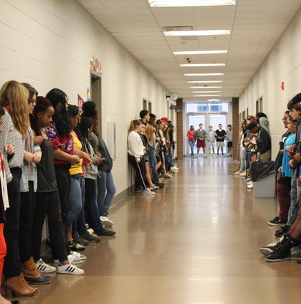
Overview
Details
Datasheet
Date 1970-2022
Location US
4 sheets
CSV
Info
More
Incident
Victim
Shooter
Weapon
30 Column 1000 Row
06 Column 1000 Row
12 Column 1000 Row
04 Column 1000 Row

Slide 3
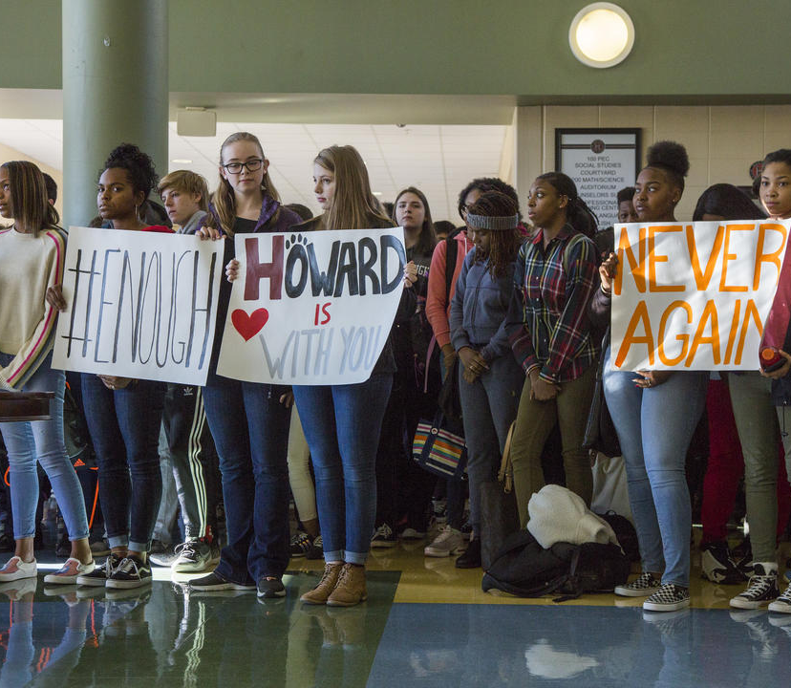
Data Description
The data is about the school shooting acts that continue to take place across US from kindergarten to 12th grade (High school),
Between years 1970 and 2022
It describes incident details and all the known info about it

Slide 4

Columns Description
Name | Sheet | Description
Incident_ID |  | Unique number that is a Key identifier across data sheets for each incident
Sources | Incident | Link of incident source from the news
Number_News | Incident | Number of new talked about the incident
Media-Attention | Incident | News headlines and details
Reliability | Incident | How much was news reliable
Date | Incident | Date of incident
Quarter | Incident | Season of incident ( Winter, Fall, Summer, Spring)
School | Incident | School name
City/ State | Incident
School Level | Incident | High school, KG ..ets
Location type | Incident | Shooting location
During School | Incident | Yes,No

Slide 5
Columns Description
Name | Sheet | Description
Time Period | Incident | Which time period of day
First shoot | Incident | Time of first Shoot
Summary | Incident | Summary of incident event
Narrative | Incident | Details about incident
Situation | Incident
Targets | Incident | Targeted people at incident (Random, Targeted,….)
Accomplice | Incident | Is their any Accomplice
Hostages | Incident | Yes, No
Barricade | Incident
Officer_Involved | Incident | Yes, No
Bullied | Incident | Shooter was bullied?
Domestic_Violence | Incident | Shooter was part of Domestic_Violence?
Gang_Related | Incident | Shooting was commeted to gang?
Preplanned | Incident | Yes, No

Slide 6
Columns Description
Name | Sheet | Description
Shots_Fired | Incident | Num of shoots
Active_Shooter_FBI | Incident
Age | Shooter/Victim | Shooter Age
Gender | Shooter/Victim
Race | Shooter/Victim
schoolaffiliation | Shooter/Victim | Relation between school and shooter
shooteroutcome | Shooter | Shooter statues after incident
shooterdied | Shooter | Yes, No
injury | Shooter/Victim
chargesfiled | Shooter
minorchargedadult | Shooter | ??
criminalhistory | Shooter
weaponcaliber | Weapon
weapondetails | Weapon
weapontype | Weapon

Slide 7
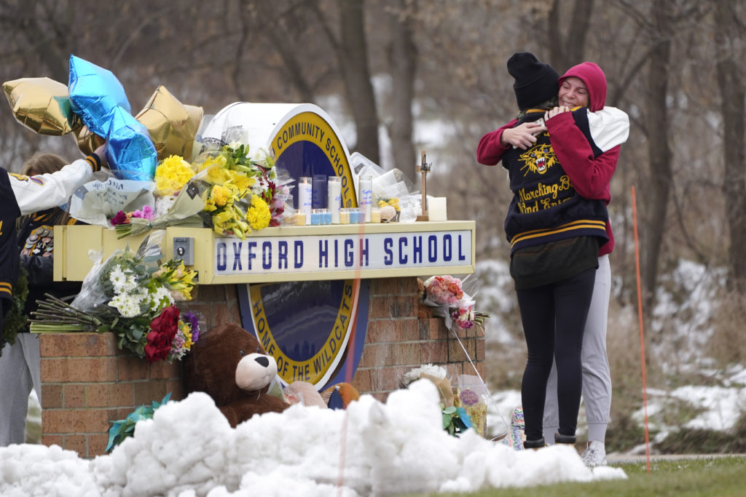
KPIs
Num of Incidents
Num of Wounded/ Death
Num of Incidents over years
Incidents per season
Top 10 cities had incidents
Percentage of recurring incident in the same city
Percentage of recurring incident in the same School
Shooting increased or decreased past 10, 5 Years?
Male Vs Female and unknown Shooters
Male Vs Female and Victims
Common age (age group) of shooter
Most reliability commit shooting
Most targeted school level
Num of Shooters from each race

Slide 8
KPIs
Shooting per period
Most used weapons
Num of shooters faced bulling
Num of shooters faced Domestic Violence
Num of shooters part of gang
Targeted per incident
Incident by location (Inside, Outside) school
Incident by location (Inside school)
Preplanned per incident

Slide 9

Thank you

